Slide 1



Apache CXF, Tika and Lucene The power of search the JAX-RS way
Andriy Redko
Notes:
Plan:
- introduce myself
- introduce apache cxf
- introduce apache tika
- introduce lucene
- describe the problem

Slide 2
About myself
Passionate Software Developer since 1999
On Java since 2006
Currently employed by AppDirect in Montreal
Contributing to Apache CXF project since 2013
http://aredko.blogspot.ca/
https://github.com/reta

Slide 3
What this talk is about …
REST web APIs are everywhere
JSR-339 / JAX-RS 2.0 is a standard way to build RESTful web services on JVM
Search/Filtering capabilities in one form or another are required by most of web APIs out there
So why not to bundle search/filtering into REST apps in generic, easy to use way?

Slide 4
Meet Apache CXF
Apache CXF is very popular open source framework to develop services and web APIs on JVM platform
The latest 3.0 release is (as complete as possible) JAX-RS 2.0 compliant implementation
Vibrant community, complete documentation and plenty of examples make it a great choice
Notes:
No access to TCK

Slide 5
Apache CXF Search Extension (I)
Very simple concept build around customizable _s / _search query parameter
At the moment, supports Feed Item Query Language (FIQL) expressions and OData 2.0 URI filter expressions
http://my.host:9000/api/people?_search=
"firstName eq 'Bob' and age gt 35"

Slide 6
FIQL
The Feed Item Query Language
IETF draft submitted by M. Nottingham on December 12, 2007 https://tools.ietf.org/html/draft-nottingham-atompub-fiql-00
Fully supported by Apache CXF
_search=firstName==Bob;age=gt=35
Notes:
[Draft]

Slide 7
OData 2.0
Uses OData URI $filter system query option http://www.odata.org/documentation/odata-version-2-0/uri-conventions
Built on top of Apache Olingo and its FilterParser implementation
Only subset of the operators is supported (matching the FIQL expressions set)
_search="firstName eq 'Bob' and age gt 35"
Notes:
[Draft]

Slide 8
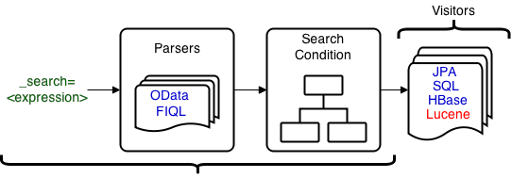
Apache CXF Search Extension (II)
Under the hood …
@GET
@Produces( { MediaType.APPLICATION_JSON } )
public Response search(@Context SearchContext context) { ... }

Slide 9
Apache Lucene In Nutshell
Leading, battle-tested, high-performance, full-featured text search engine
Written purely in Java
Foundation of many specialized and general-purpose search solutions (including Solr and Elastic Search)
Current major release branch is 5.x

Slide 10
Apache CXF Search Extension (III)
LuceneQueryVisitor maps the search/filter expression into Apache Lucene query
Uses QueryBuilder and is analyzer-aware (means stemming, stop words, lower case, … apply if configured)
Apache Lucene 4.7+ is required (4.9+ recommended)
Subset of Apache Lucene queries is supported (many improvements in upcoming 3.1 release)

Slide 11
Lucene Query Visitor
Is type-safe but supports regular key/value map (aka SearchBean) to simplify the usage
@GET
@Produces( { MediaType.APPLICATION_JSON } )
public Response search(@Context SearchContext context) {
final LuceneQueryVisitor< SearchBean > visitor =
new LuceneQueryVisitor< SearchBean >(analyzer);
visitor.visit(context.getCondition(SearchBean.class));
final IndexReader reader = ...;
final IndexSearcher searcher = new IndexSearcher(reader);
final Query query = visitor.getQuery();
final TopDocs topDocs = searcher.search(query, 10);
...
}
Notes:
Comments about type-safety here

Slide 12
Supported Lucene Queries
TermQuery
PhraseQuery
WildcardQuery
NumericRangeQuery (int / long / double / float)
TermRangeQuery (date)
BooleanQuery (or / and)

Slide 13

TermQuery Example
_search=firstName==Bob
_search="firstName eq 'Bob'"
FIQL
OData
firstName:bob
Notes:
Make sure this query works!

Slide 14
PhraseQuery Example
_search=content=='Lucene in Action'
_search="content eq 'Lucene in Action'"
FIQL
OData
content:"lucene ? action"
* in is typically a stopword and is replaced by ?
Notes:
Make sure this query works!

Slide 15
WildcardQuery Example
_search=firstName==Bo*
_search="firstName eq 'Bo*'"
FIQL
OData
firstName:Bo*

Slide 16
NumericRangeQuery Example
_search=age=gt=35
_search= "age gt 35"
FIQL
OData
age:{35 TO *}
* the type of age property should be numeric
visitor.setPrimitiveFieldTypeMap(singletonMap("age", Integer.class))

Slide 17
TermRangeQuery Example
_search=modified=lt=2015-10-25
_search= "modified lt '2015-10-25'"
FIQL
OData
modified:{* TO 20151025040000000}
* the type of modified property should be date
visitor.setPrimitiveFieldTypeMap(singletonMap(“modified", Date.class))

Slide 18
BooleanQuery Example
_search=firstName==Bob;age=gt=35
_search= "firstName eq 'Bob' and
age gt 35"
FIQL
OData
+firstName:bob +age:{35 TO *}

Slide 19
From “How …” to “What …”
Files are still the most widespread source of valuable data
However, most of file formats are either binary (*.pdf, *.doc, …) or use some kind of markup (*.html, *.xml, *.md, …)
It makes the search a difficult problem as the raw text has to be extracted and only then indexed / searched against

Slide 20
Apache Tika
Metadata and text extraction engine
Supports myriad of different file formats
Pluggable modules (parsers), include only what you really need
Extremely easy to ramp up and use
Current release branch is 1.7

Slide 21
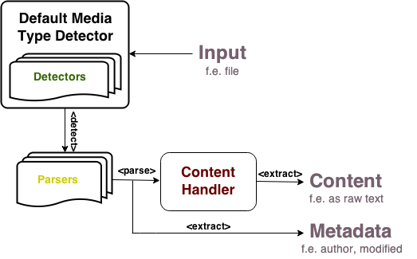
Apache Tika in Nutshell

Slide 22
Text Extraction in Apache CXF
Provides generic TikaContentExtractor
Also has specialization for Apache Lucene, TikaLuceneContentExtractor
public class TikaContentExtractor {
public TikaContent extract(final InputStream in) {
...
}
}
public class TikaLuceneContentExtractor {
public Document extract(final InputStream in) {
...
}
}
Notes:
TikaContent is generic representation of raw text and metadata, extracted form the file
TikaLuceneContentExtractor returns ready to use Lucene document, which could be indexed right away

Slide 23
And finally, indexing …
The text and metadata extracted from the file could be added straight to Lucene index
final TikaLuceneContentExtractor extractor =
new TikaLuceneContentExtractor(new PDFParser());
final Document document = extractor.extract(in);
final IndexWriter writer = ...;
try {
writer.addDocument(document);
writer.commit();
} finally {
writer.close();
}

Slide 24
Demo
https://github.com/reta/ApacheConNA2015

Slide 25
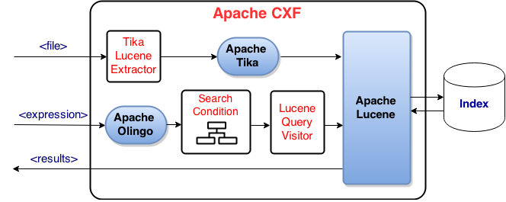
Demo: Gluing All Parts Together …

Slide 26
Apache CXF Search Extension (IV)
Configuring expressions parser
search.parser.class=ODataParser
search.parser=new ODataParser()
Configuring query parameter name
search.query.parameter.name=$filter
Configuring date format
search.date-format=yyyy/MM/dd

Slide 27
Alternatives
ElasticSearch: is a highly scalable open-source full-text search and analytics engine (http://www.elastic.co/)
Apache Solr: highly reliable, scalable and fault tolerant open-source enterprise search platform (http://lucene.apache.org/solr/)
These are dedicated, best in class solutions for solving difficult search problems.
Notes:
[Draft]

Slide 28
Useful links
http://cxf.apache.org/docs/jax-rs-search.html
http://lucene.apache.org/
http://tika.apache.org/
http://olingo.apache.org/
http://aredko.blogspot.ca/2014/12/beyond-jax-rs-spec-apache-cxf-search.html

Slide 29
Thank you!
Many thanks to Apache Software Foundation and AppDirect for the chance to be here

